Slide 1
Topic Modeling
July 11, 2022

Slide 2
Topic Modeling
Unsupervised machine learning method to identify topics within documents
Not classifying anything
Qualitative/Quantitative method
We will need to label the topics at the end but we can still evaluate with a few quantitative metrics (topic coherence, topic diversity)
Common Method – Latent Dirichlet Allocation (LDA)
Matrix factorization technique – probabilities of probabilities
“Each document can be described by the probabilistic distribution of topics and each topic can be described by the probabilistic distribution of words”
Notes:
https://towardsdatascience.com/nlp-preprocessing-and-latent-dirichlet-allocation-lda-topic-modeling-with-gensim-713d516c6c7d
Source: https://towardsdatascience.com/nlp-preprocessing-and-latent-dirichlet-allocation-lda-topic-modeling-with-gensim-713d516c6c7d

Slide 3
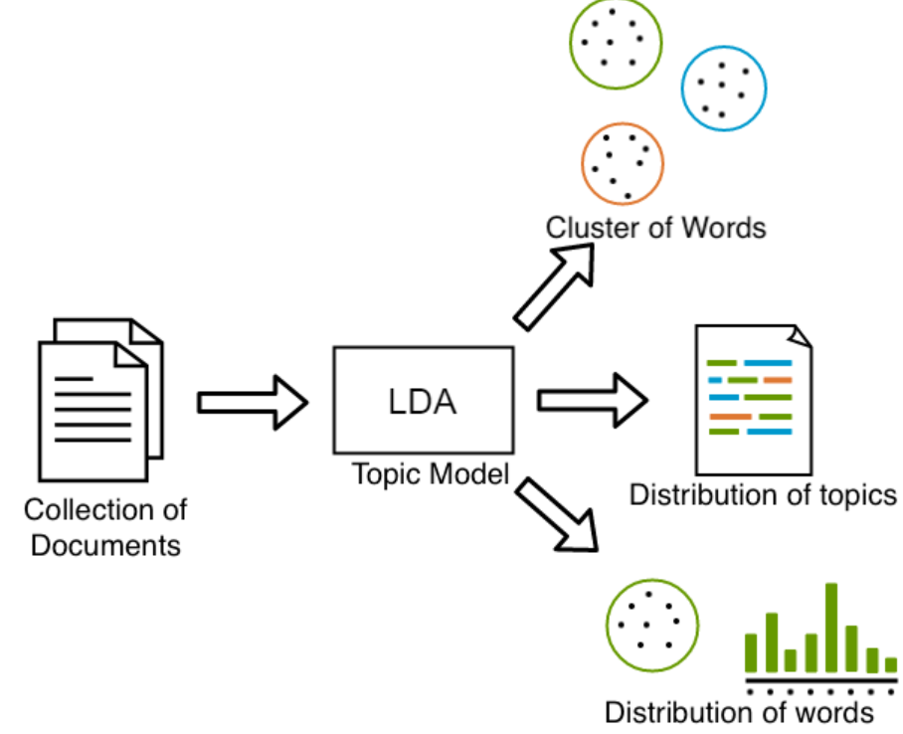
LDA Topic Modeling
“Distribution of distributions”
Distribution of topics in documents
Distribution of words in the topic
Allocation topics back to the documents and words of the document to the topic
https://www.researchgate.net/figure/Topic-modeling-with-LDA_fig3_345881590
Notes:
https://www.researchgate.net/figure/Topic-modeling-with-LDA_fig3_345881590
https://medium.com/analytics-vidhya/topic-modeling-using-lda-and-gibbs-sampling-explained-49d49b3d1045

Slide 4
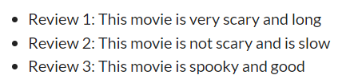
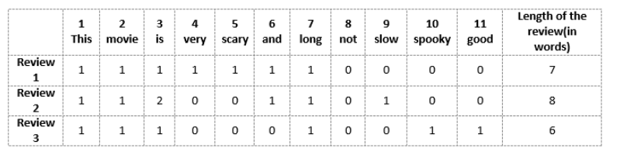
LDA – Topic Modeling
Bag-of-words (BOW) approach
How many times does each word appear in each document
https://www.analyticsvidhya.com/blog/2020/02/quick-introduction-bag-of-words-bow-tf-idf/
Notes:
Image (Purva Huilgol): https://www.analyticsvidhya.com/blog/2020/02/quick-introduction-bag-of-words-bow-tf-idf/

Slide 5
Limitations of BOW Approach?
Does not capture order of words, grammar, semantics
Many 0s → sparse matrix

Slide 6
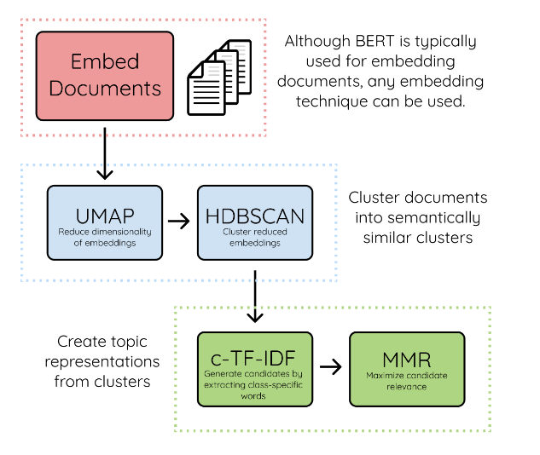
BERTopic

Slide 7
Why use BERTopic
Conventional models LDA and Non-Negative Matrix Factorization describe documents as bag-of-words (BOW)
This limits modeling/consideration of semantic relationship among words
Thus, may fail to accurately represent documents
BERTopic leverages embeddings
Embedding methods can capture semantic meaning of text
Previous embedding topic modeling techniques rely on representing topics based on the words closest to a cluster’s centroid
Clusters do not always lie within a sphere around a cluster centroid – thus, these representation method may be limited

Slide 8
BERTopic
Neural topic modeling with a class-based TF-IDF procedure
Use pre-trained transformer-based language models to generate document embeddings to obtain document-level information
Reduce dimensionality of document embeddings with UMAP
Clustering embeddings with HDBSCAN
Generate topic representations with the class-based TF-IDF procedure
TF-IDF modified here to represent a term’s importance to a topic, rather than a document

Slide 9
1. Generate document Embeddings
BERTopic assumes that documents containing the same topic are semantically similar
BERTopic uses embeddings from Sentence-BERT (SBERT) to convert sentences and paragraphs to dense vector representations
We can choose our own pre-trained embeddings
These embeddings are used to cluster semantically similar documents and not for directly generating the topics

Slide 10
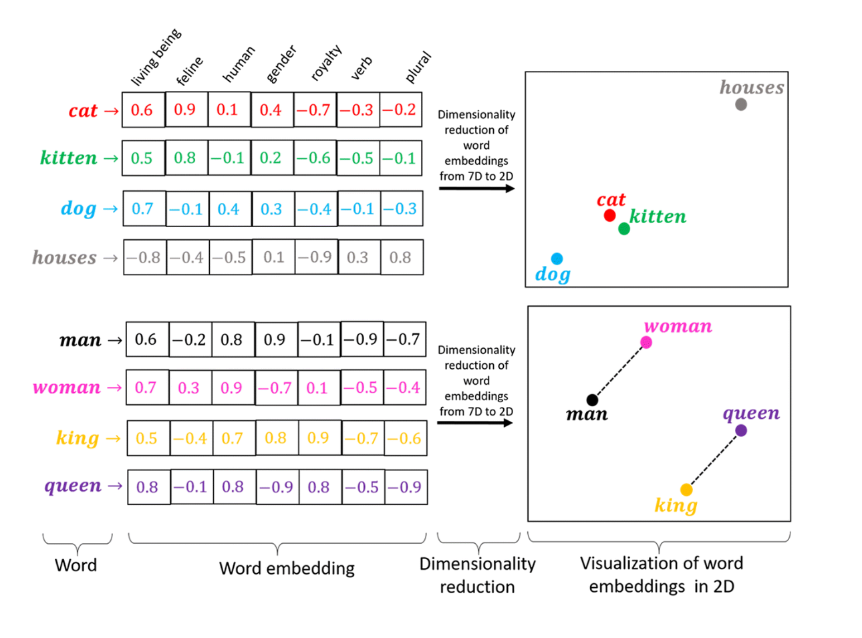
Word Embeddings
Notes:
https://stackoverflow.com/questions/72545744/how-to-convert-small-dataset-into-word-embeddings-instead-of-one-hot-encoding

Slide 11
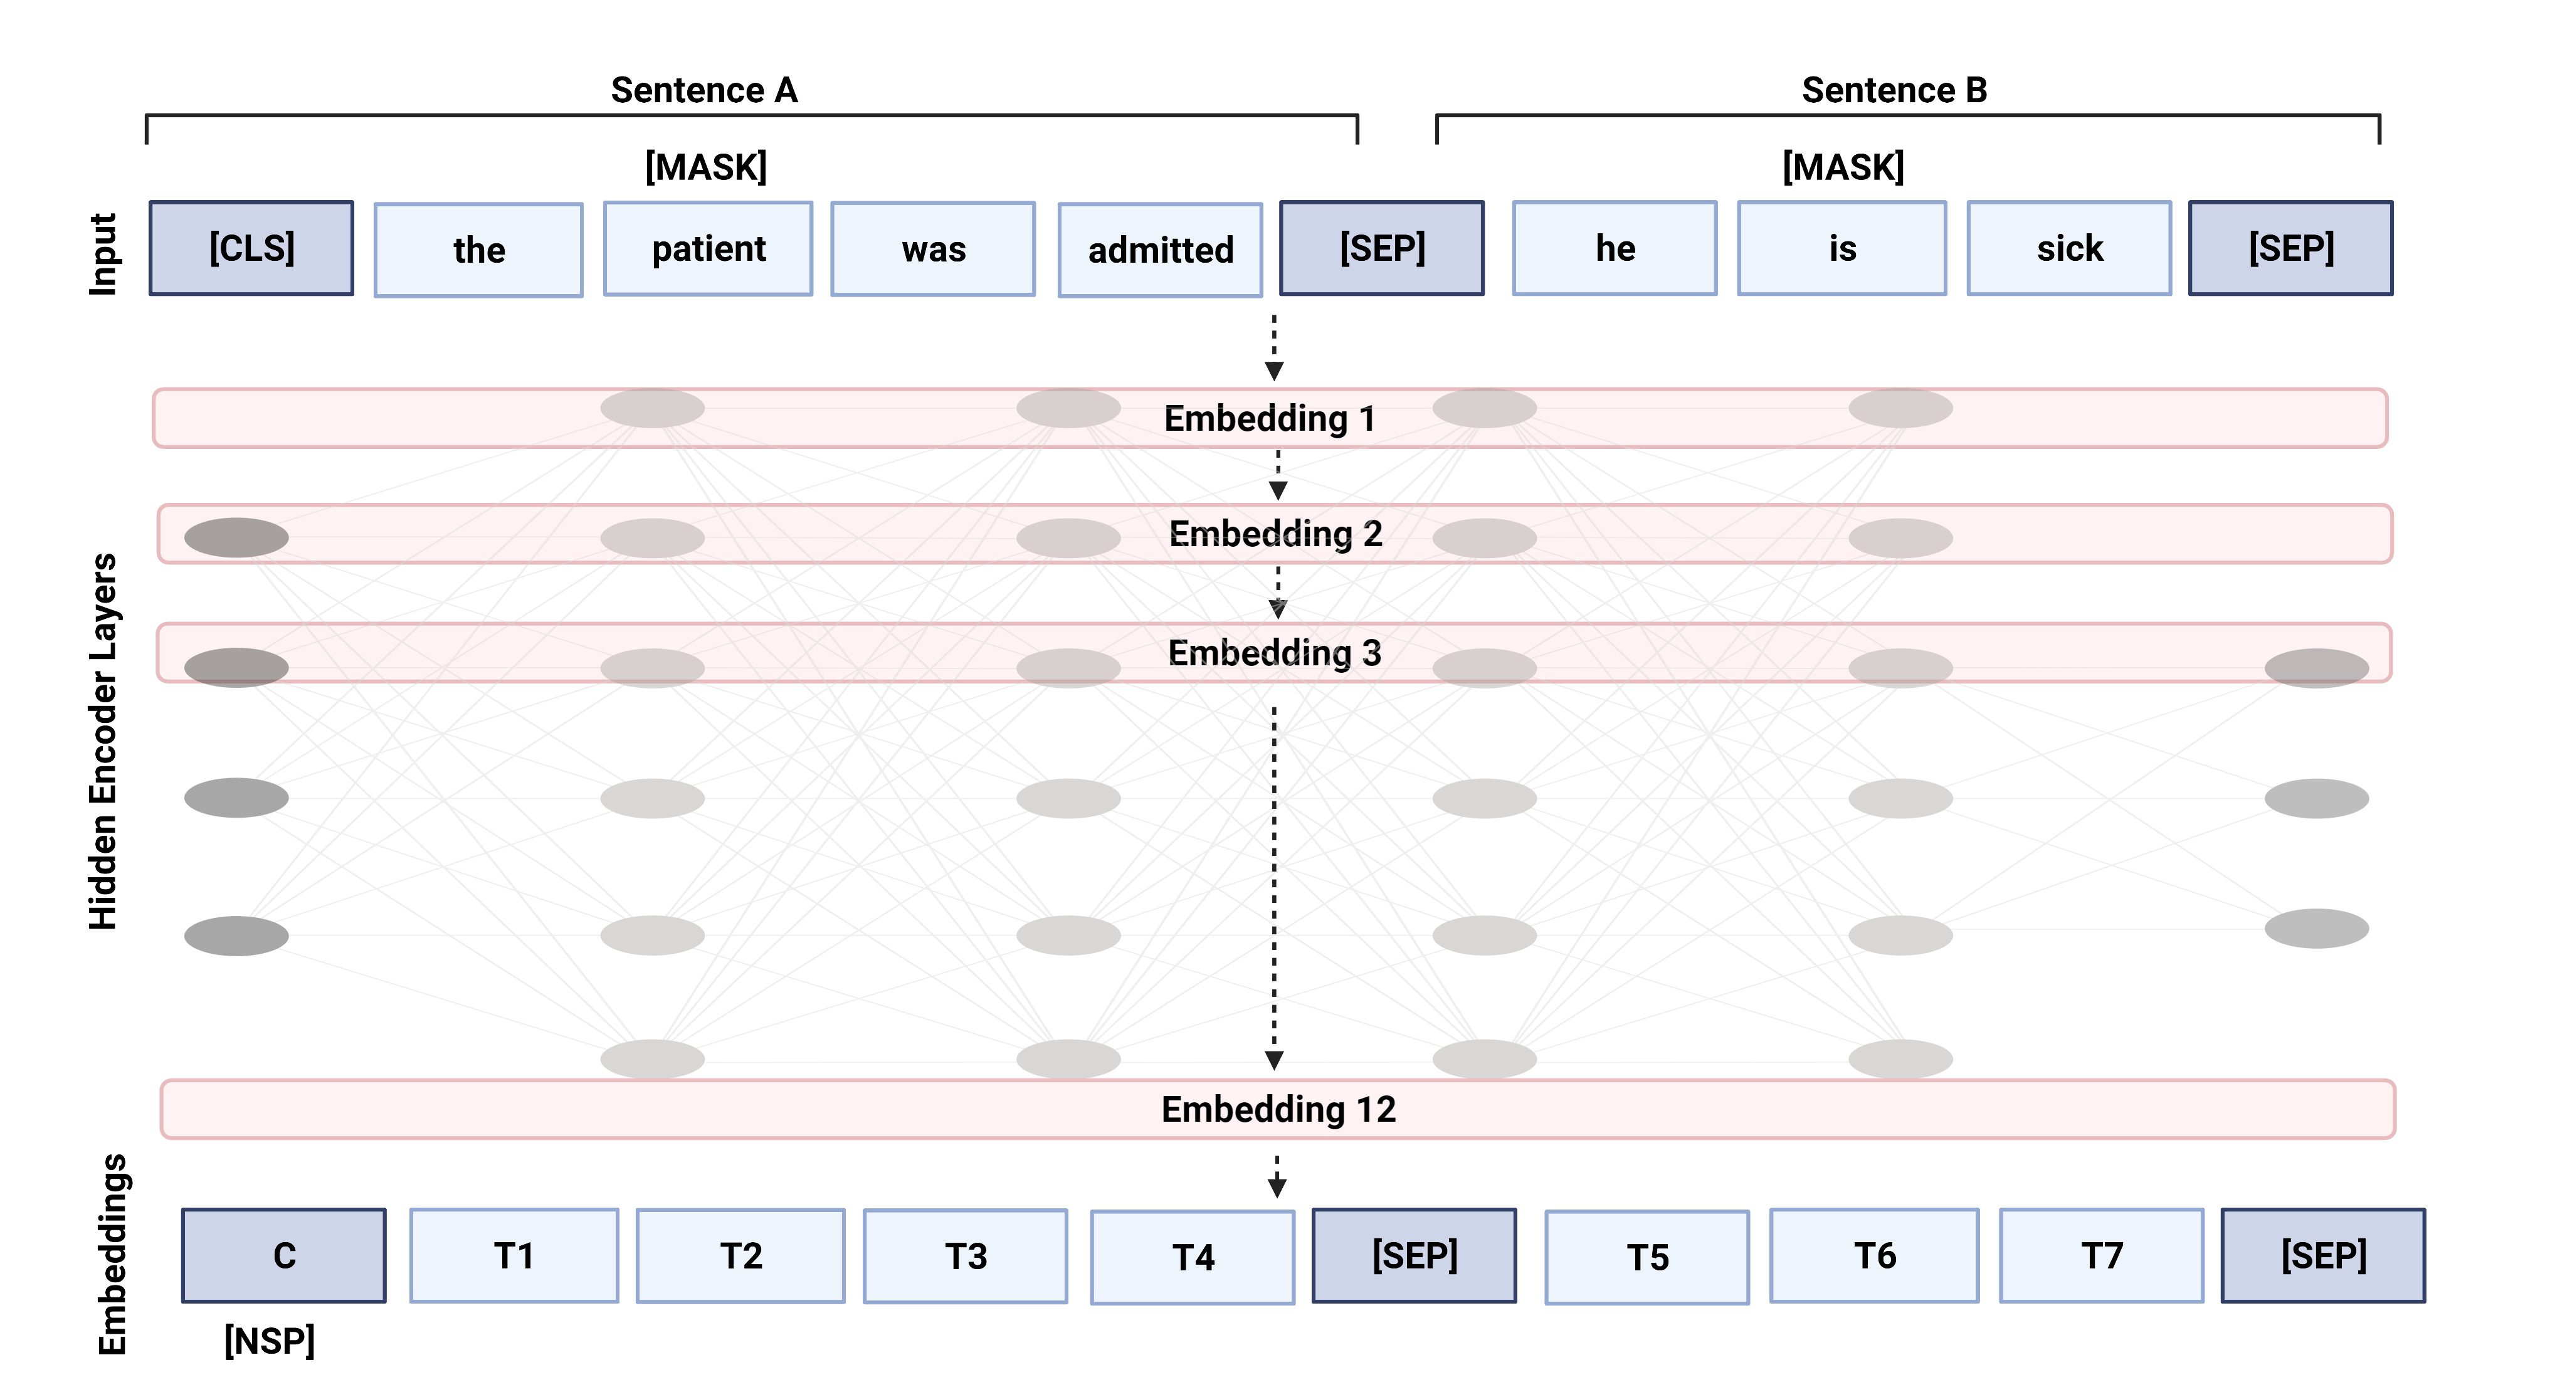
BERT Word Embedding Method

Slide 12
BERT Word Embedding Method
Word embedding method
Takes in two sentences/sequences of input and initiates bidirectional pre-training of word embeddings using Masked Language Model Technique – randomly masks 15% of words
Model trains “bidrectionally” by learning to predict the masked word using the words to the left and right of it in the sequence
The standard BERT model also has 12 embedding layers. These apply attention throughout to facilitate deeper identification of the most salient/associated words
Pre-training of the embedding is facilitated by a Next Sentence Prediction Task – where the second input sentence only has a 50% chance of actually being the next sentence

Slide 13
2. Reduce Dimensionality of embeddings
First, UMAP is used to reduce the dimensionality of the embeddings before clustering
UMAP has been shown to preserve more of the local and global features of high-dimensional data in lower projected dimensions

Slide 14
3. Cluster the embeddings
HDBSCAN is used to cluster the UMAP reduced embedings
Finds clusters of varying densities via a hierarchical clustering algorithm
Uses a soft-clustering approach which allows noise to be modeled as outliers
“This prevents unrelated documents to be assigned to any cluster and is expected to improve topic representations”

Slide 15
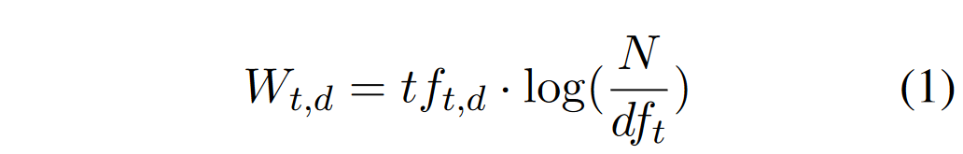
4. Topic Representation with class-based TF-IDF
term frequency-inverse document frequency (TF-IDF) – a metric of a word’s importance to a document
Standard TF-IDF formula:
Multiply the frequency of term t in document d multiplied by the log(total number of docs in a corpus / total number of documents that contain term t
Thus, very frequent words like “the” which likely appear in every documents, will have very little weight

Slide 16
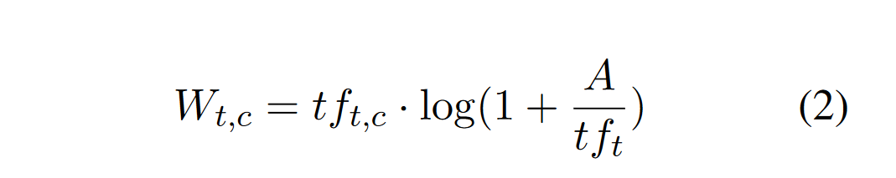
4. Topic Representation with class-based TF-IDF
For BERTopic, we modify TF-IDF to work on our clusters of documents
Consider all documents in a cluster as a single document by concatenating all documents (tweets in our case)
New formula:
Multiply the frequency of term t in class c (cluster) multiplied by the log(1 + total number of words per class/cluster A / frequency of term t across all classes/clusters
This TF-IDF algorithm identifies the importance of words in clusters and thus generate topic-word distributions for each cluster

Slide 17
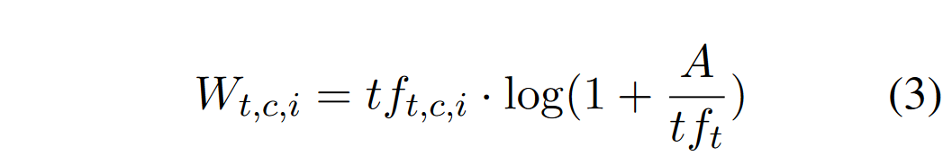
5. Dynamic Topic Modeling
When using BERTopic, we create global topic representations which do not consider time
Then we can consider time in order to create a local topic representation
Local representations of each topic are created by multiplying the term frequency of documents (or clusters?) at timestep I with the pre-calculated global IDF values

Slide 18
5. Dynamic Topic Modeling
When we assume that timestep t depends on topic at timestep t-1, we can leverage the c-TF-IDF matrices that were created at each timestep to incorporate the linear assumption that time t evolves from timestep t-1
For each topic and timestep, the c-TF-IDF vector is normalized by dividing the vector with the L1-normal -> this normalization procedure prevents topic representations from having disproportionate effects as a result of the size of the documents that make up a topic
For each topic and representation at timestep t, we simply take the average of the normalized c-TF-IDF vectors at t and t-1
For each topic and representation at timestep t, we take the average of the normalized c-TF-IDF vectors at t and t-1
this allows us to influence the topic representation at time t by incoproating the representation at t-1

Slide 19
Evaluating topics
Topic coherence
Quantified the semantic similarity between top words in a topic
NPMI (Normalized pointwise mutual information)
Normalized to -1 to 1, where 1 is perfect association
Topic diversity
% of unique words for all topics
0 to 1, where 0 indicates redundant topics and 1 indicates more varied topics
We will also need to qualitatively evaluate the topics – do these make sense to us
Notes:
https://towardsdatascience.com/evaluate-topic-model-in-python-latent-dirichlet-allocation-lda-7d57484bb5d0

Slide 20
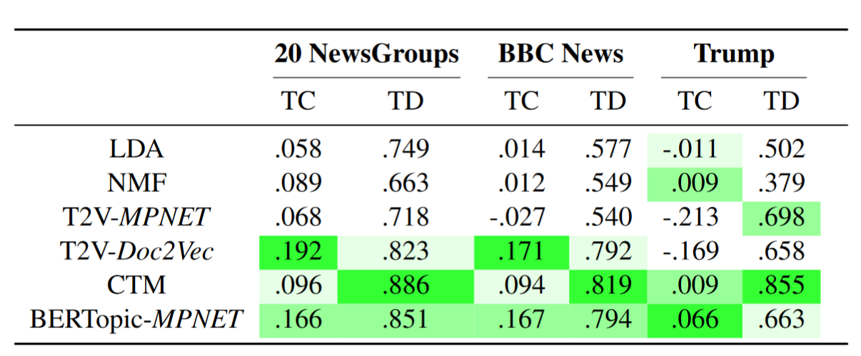
Results

